Slide 1

ARTIFICIAL INTELLIGENCE
&
MACHINE LEARNING
SESSION -4
Problem Formulation
States, transitions, costs, search spaces, applications.

Slide 2
Objectives
1. To introduce the concept and significance of problem formulation in Artificial Intelligence.
2. To explain the six key components of a search problem: initial state, actions, transition model, goal test, path cost, and search space.
3. To demonstrate how problem formulation supports the design of efficient AI solutions.
4. To explore real-life AI scenarios and explain how they are structured as search problems.
5. To develop the ability to formulate AI problems for use in algorithms and intelligent agents.

Slide 3
Problem Formulation
Problem Formulation:
Problem formulation is the process of defining a problem in a structured and solvable way so that an AI agent can apply search algorithms to find a solution.
Core components of problem formulation in AI
1. Initial State
2. Actions (Operators)
3. Transition Model
4. Goal Test
5. Path Cost
6. Search Space

Slide 4
CONTD..
1. Initial State
The initial state represents the starting point of the agent in the environment.
It is the situation in which the agent begins its task.
For example, in a navigation task, the initial state could be the starting location of a vehicle or robot.
The entire search begins from this state.
2. Actions (Operators)
Actions are the set of all legal moves or operations that an agent can perform in a particular state.
These are often also referred to as operators.
The set of actions varies based on the problem domain.
In a maze-solving problem, actions may include "move forward," "turn left," or "turn right."
These actions allow the agent to transition between states.

Slide 5
3. Transition Model
The transition model defines what happens when an action is applied to a state.
It answers the question: "If the agent is in state S and performs action A, what will the resulting state S' be?"
This is also written as: Result(S, A) = S'.
The transition model can be deterministic, where each action always results in the same outcome, or stochastic, where actions can lead to different possible outcomes.
4. Goal Test
The goal test determines whether a given state is a goal state.
It is a condition or set of conditions that the agent uses to evaluate whether it has found a solution.
For instance, in the 8-puzzle problem, the goal test checks whether the tiles are in a specific order.

Slide 6
5. Path Cost
Path cost is a measure of the total cost incurred by the agent to reach a goal state from the initial state.
Each action has a cost, and the path cost is the cumulative cost of all actions taken along the way.
The objective of many AI search algorithms is not just to find any solution, but to find the one with the least path cost (optimal solution).

Slide 7
6. Search Space
The search space refers to the entire set of possible states the agent can reach from the initial state by applying actions. It is usually visualized as a search tree or graph, where nodes represent states and edges represent actions.
Depending on the problem, the search space can be finite or infinite, and exploring it efficiently is key to effective problem-solving.

Slide 8
Steps in Problem Formulation
The process of problem formulation in AI involves structuring a real-world issue into a well-defined computational problem that an AI system can solve. This requires defining the problem’s scope, specifying possible actions, and setting constraints to guide the AI toward an optimal solution. Below are the essential steps in problem formulation.
Step 1: Define the Problem Statement
The first step is to clearly define the problem AI needs to solve. This involves identifying the real-world challenge, its objectives, and constraints. A well-defined problem helps AI agents apply the appropriate algorithms for efficient decision-making.

Slide 9
Example: In an AI-based package delivery system, the problem statement could be:
Deliver a package from Warehouse A to Customer B.
Minimize delivery time and fuel consumption.
Adapt to traffic conditions and weather changes.

Slide 10
Step 2: Establish the Initial State and Goal State
The initial state: The starting conditions of the system.
The goal state: The desired outcome after executing AI-driven actions.
For the package delivery AI, the:
Initial state is the package at Warehouse A.
Goal state is the successful delivery to Customer B within the shortest possible time.

Slide 11
Step 3: Determine Available Actions and State Transition Model
Next, AI must determine what actions it can take and how those actions impact the problem state.
Available actions: The AI’s possible moves in response to real-world conditions.
State transition model: How each action modifies the AI’s state.
For the package delivery AI, actions include:
Move forward (advance to the next road segment).
Turn left or right (change direction at intersections).
Stop (wait for traffic signals or customer confirmation).
The transition model helps AI predict the next state based on chosen actions, ensuring logical and efficient problem-solving.

Slide 12
Step 4: Define Constraints and Path Cost
Constraints: Conditions that restrict available solutions (e.g., traffic rules, package weight limits, or delivery deadlines).
Path cost function: A metric used to determine the most optimal solution based on the least cost (e.g., shortest path, lowest fuel consumption).
For the package delivery AI, optimization factors may include:
Shortest distance to the destination.
Minimized fuel consumption.
Avoiding congested roads for faster delivery.

Slide 13
Example of Problem Formulation in AI: Autonomous Package Delivery
Autonomous package delivery is a real-world AI application where an AI system plans and executes an optimal delivery route while considering factors like fuel efficiency, delivery time, and road conditions. Below, we formulate this problem with code snippets demonstrating each key component, followed by a final implementation.
Initial State
The initial state represents the starting conditions of the AI system before any action is taken.
The package is at Warehouse A, ready for dispatch.
The autonomous delivery vehicle is stationed at the warehouse, awaiting route instructions.

Slide 14
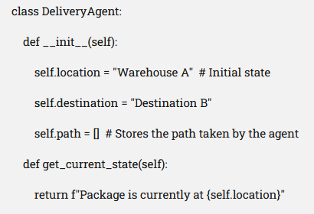

Slide 15
Action Set
The action set defines the AI’s possible moves to navigate toward its goal.
Available Actions:
Move Forward – Continue in the current direction.
Turn Left – Change direction at an intersection.
Turn Right – Navigate an alternative route.
Stop – Halt movement due to an obstacle or delivery confirmation.

Slide 16
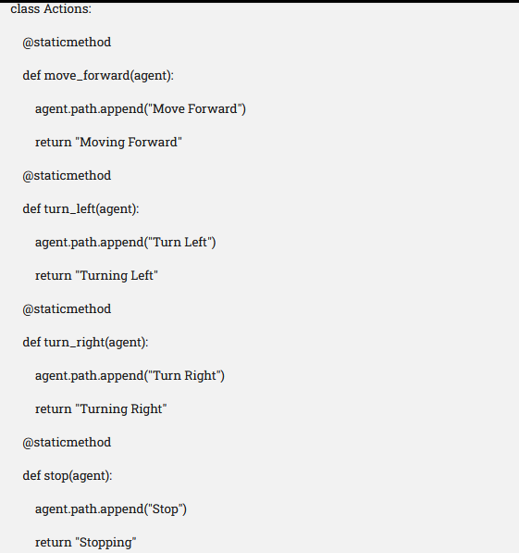

Slide 17
Transition Model
The transition model describes how the system moves from one state to another based on the actions performed.
If the AI chooses Move Forward, the system updates its current GPS location.
If the AI selects Turn Left or Turn Right, it updates its heading and direction accordingly.

Slide 18
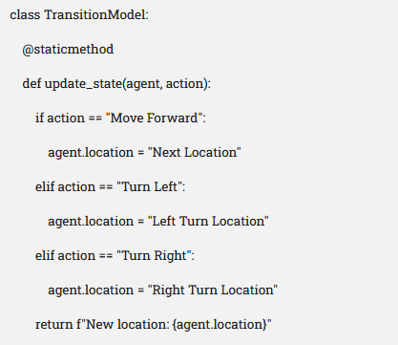
CONTD..

Slide 19
Goal State
The goal state defines the successful completion of the AI’s task.
The package is delivered to Destination B.
Time and fuel efficiency are optimized.

Slide 20


Slide 21
Path Cost Function
The path cost function evaluates the efficiency of different routes and ensures optimal decision-making.
Fuel efficiency – Selecting routes with lower energy costs.
Delivery time – Prioritizing the fastest path while avoiding unnecessary detours.

Slide 22


Slide 23
Applications of Problem Formulation
Robot Navigation: From one point to another avoiding obstacles
Logistics & Delivery: Optimal routing of delivery vehicles
Game Playing: Strategic decision-making in games like chess
Scheduling: Assigning tasks to time slots efficiently
Medical Diagnosis: Finding the illness that best explains the symptoms
Theorem Proving: Finding a sequence of logical deductions

Slide 24
Challenges in Problem Formulation
Problem formulation in AI comes with various challenges that affect accuracy, efficiency, and decision-making. Some key difficulties include:
Complexity of Real-World Problems – AI must handle uncertainty, dynamic environments, and incomplete data, making problem structuring difficult.
Defining the Correct Goal – Some AI applications involve conflicting objectives (e.g., balancing speed and fuel efficiency in autonomous vehicles).
Computational Constraints – AI-driven systems often require large-scale processing power, making optimization crucial.
Ethical Considerations – AI in healthcare, finance, and law must follow fairness, privacy, and transparency guidelines to ensure responsible decision-making.

